Slide 1
International Taxation
Alan Auerbach
October 1, 2020

Slide 2
Outline
Overview, Theory, and Evidence
A Changing Economic Setting
Tax Reforms and Their Effects

Slide 3
Overview, Theory, and Evidence

Slide 4
What is Our Focus?
Most research and policy attention is devoted to foreign direct investment (FDI) – the direct cross-border ownership of assets by firms
  This is true even though foreign portfolio investment (FPI) is bigger: at the end of 2019, US FDI = $8.8T; US FPI = $13.4T (from BEA IIP data)
FDI receives most of the attention because
  There is a lot more going on in terms of behavior
  It is tied more to policy issues (e.g., jobs, productivity, etc.)

Slide 5
How is FDI Income Taxed?
For equity investment (e.g., a US corporation owns a subsidiary abroad), many possibilities; two main approaches historically have been:
  Territorial – collect tax where the US parent and its subsidiary each “earn” their income
  Worldwide – collect tax where the US parent company “resides” regardless of where income is “earned”

Slide 6
Territorial vs. Worldwide Taxation
Territorial Taxation
Residence\Source | Home | Abroad
Home | t | 0
Abroad | t | 0
Worldwide Taxation
Residence\Source | Home | Abroad
Home | t | t
Abroad | 0 | 0

Slide 7
Territorial vs. Worldwide Taxation
Territorial Taxation
Residence\Source | Home | Abroad
Home | t | 0
Abroad | t | 0
Worldwide Taxation
Residence\Source | Home | Abroad
Home | t | t max [(t – t^{f})/(1– t^{f}),0]*
Abroad | 0 t | 0
*Collected only upon repatriation
So, in practice, systems not as distinct as they initially appear, but some important differences remain

Slide 8
Territorial vs. Worldwide Taxation
The deferral aspect of worldwide taxation should discourage repatriations, especially if effective tax rates on repatriations are expected to fall

Slide 9
Territorial vs. Worldwide Taxation
The deferral aspect of worldwide taxation should discourage repatriations, especially if effective tax rates on repatriations are expected to fall
  A huge US repatriation response to a one-year reduction in repatriation tax rates (from 2004 American Jobs Creation Act), although Dharmapala, Foley, and Forbes (JF 2011) estimate little direct impact on real activity
Notes:
Used IV approach to predict repatriations based on change in repatriation tax rate and other covariates.

Slide 11
Territorial vs. Worldwide Taxation
The deferral aspect of worldwide taxation should discourage repatriations, especially if effective tax rates on repatriations are expected to fall
  A big increase in repatriations after the 2017 TCJA, which eliminated the tax on US repatriations

Slide 12
Territorial vs. Worldwide Taxation
TCJA
AJCA
Source: BEA

Slide 13
Territorial vs. Worldwide Taxation
Worldwide taxation should make resident companies less sensitive to tax rate variations among countries where they do FDI.

Slide 14
Territorial vs. Worldwide Taxation
Worldwide taxation should make resident companies less sensitive to tax rate variations among countries where they do FDI.
  Liu (AEJ:EP 2020) evaluates the impact of 2009 UK shift from worldwide to territorial taxation; finds the reform increased the investment rate of UK multinationals relative to non-UK multinationals in low‑tax countries (with little impact on relative investment in high-tax countries)

Slide 15
Territorial vs. Worldwide Taxation
Worldwide taxation should make resident companies’ investment less sensitive to home-foreign tax rate variations
  Liu also finds a net reduction in domestic UK investment among UK multinationals as a result of the shift to territorial taxation

Slide 16
Territorial vs. Worldwide Taxation
Worldwide taxation should discourage profit shifting by resident companies
Profit shifting involves moving profits reported to tax authorities from one (high-tax) country to another (low-tax) country, with little or no associated change in real economic activity
  Without the need to move real activity, the profits can be shifted to tax havens – countries with low tax rates but not necessarily much economic activity

Slide 17
Profit Shifting: A Primer
Key methods of profit shifting are
  Intracompany borrowing; e.g, have affiliate in high-tax country borrow for the multinational group and deduct all of the group’s interest there

Slide 18
Profit Shifting: A Primer
Key methods of profit shifting are
  Manipulation of internal transfer prices; e.g., have U.S. parent buy a paper clip for $1 billion from its Cayman Islands subsidiary, increasing tax deductible US costs and CI “taxable” profits each by $1 billion

Slide 19
Profit Shifting: A Primer
Key methods of profit shifting are
  Cost-sharing arrangements; e.g., have U.S. parent and its Irish subsidiary engage in a joint research venture, with a substantial share of resulting IP assets and their earnings to be reported in Ireland

Slide 20
Territorial vs. Worldwide Taxation
Worldwide taxation should discourage profit shifting by resident companies (since gains from shifting are lower, ceteris paribus)
  Some tentative evidence that this is true (Markle Contemporary Accounting Research 2016)
  But also evidence of substantial profit shifting in the US prior to 2017 (when it still had a worldwide system); e.g., Dowd, Landefeld, and Moore (J. Pub. Econ. 2017)
Notes:
DLM look at responsiveness to host country tax rates, which change over time.

Slide 21
Territorial vs. Worldwide Taxation
Worldwide taxation should encourage inversions (i.e., shift in parent’s location to a country that imposes territorial taxation)
  Even if the parent’s tax rate doesn’t change, inverting will lower the tax on profits earned in other, low-tax countries (e.g. – prior to 2018 – shifting corporate residence from US to Canada would have eliminated parent-country taxes on profits earned in Ireland)
Notes:
Little evidence on sensitivity to changes in tax rates over time

Slide 22



Inversions
Notes:
Could also accomplish via a merger with a non-US company

Slide 23
Inversions
Notes:
Could also accomplish via a merger with a non-US company

Slide 24
Territorial vs. Worldwide Taxation
Lots of evidence detailing substantial behavioral responses on many margins
Also, significant policy changes over time, suggesting changes in perceived optimal policies (in a complicated environment of tax cooperation and competition)
  A shift toward territorial taxation: UK (2009), Japan (2009), US (2017)
  And steady tax rate reductions
    Note - tax rates are strategic complements (Devereux and Loretz NTJ 2013)

Slide 25
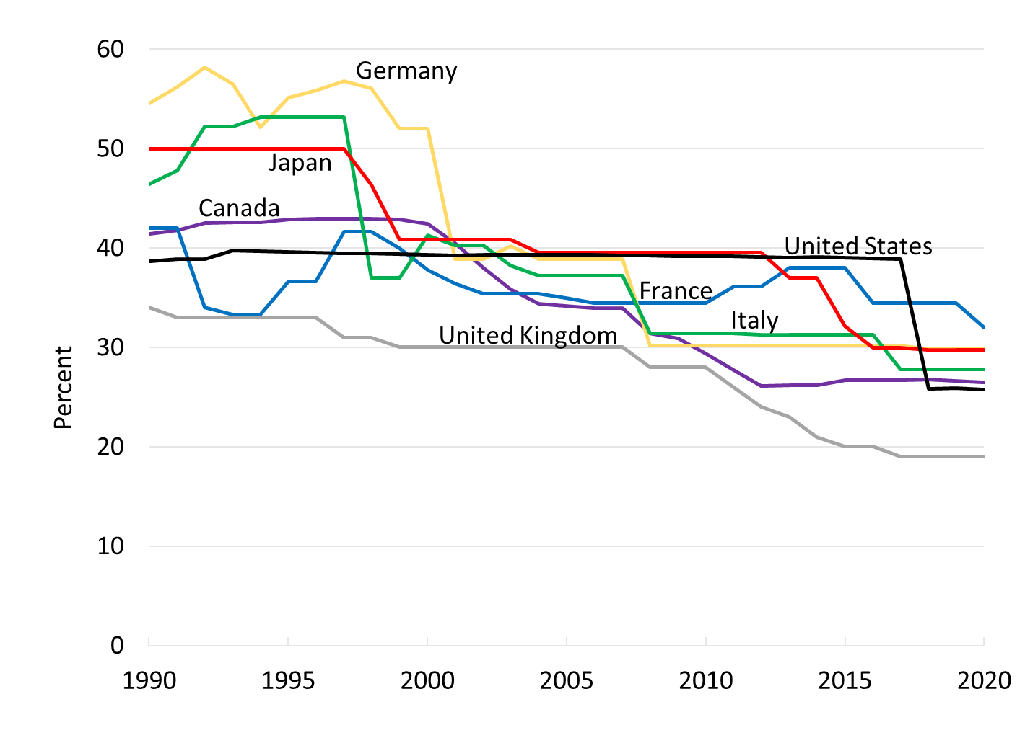
G-7 Corporate Tax Rates
Source: OECD

Slide 26
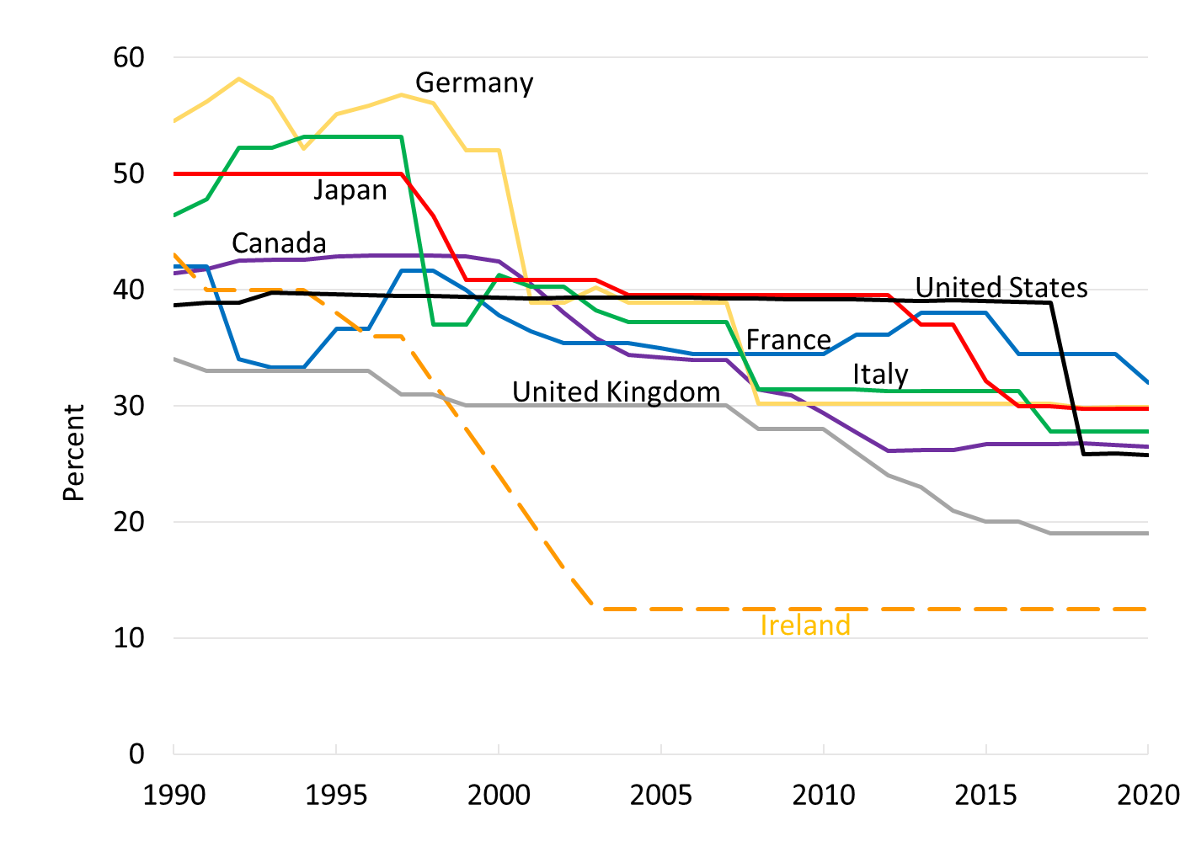
G-7 Corporate Tax Rates
Source: OECD

Slide 27
A Changing Economic Setting

Slide 28
Top Five US Companies
1966:
AT&T
IBM
GENERAL MOTORS
EXXON MOBIL
EASTMAN-KODAK

Slide 29
Top Five US Companies
1966:
AT&T
IBM
GENERAL MOTORS
EXXON MOBIL
EASTMAN-KODAK
2016:
APPLE
ALPHABET
MICROSOFT
EXXON MOBIL
AMAZON

Slide 30
Top Five US Companies
1966:
AT&T
IBM
GENERAL MOTORS
EXXON MOBIL
EASTMAN-KODAK
2016:
APPLE
ALPHABET
MICROSOFT
EXXON MOBIL
AMAZON
Facebook

Slide 31
A Changing Economic Setting
In half century ending in 2016 (see Auerbach BPEA 2017),
Share of IP in US nonresidential assets doubled (BEA, Fed FOF)
Share of before-tax corporate profits of US resident companies coming from overseas operations nearly quintupled (BEA)
Share of cross-border ownership of equity has steadily increased (Rosenthal, Tax Notes 2017)

Slide 33
Implications
Increased pressure on tax systems based on where companies have residence
With greater multinational activity and foreign ownership, easier to engage in inversion

Slide 34
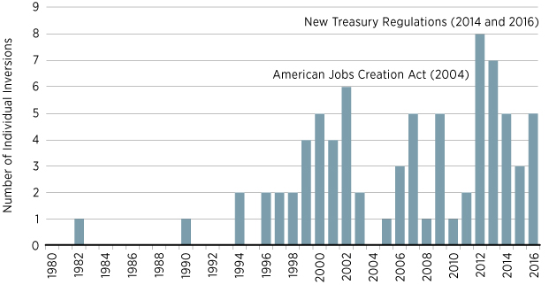
Corporate Inversions Per Year
Source: Neely and Sherrer, “A Look at Corporate Inversions, Inside and Out,” FRB St. Louis, 2017
Notes:
Law in 2004 and regulations in 2014 and 2016 made inversions more difficult.

Slide 35
Implications
Increased pressure on tax systems based on where companies have residence
With greater multinational activity and foreign ownership, easier to engage in inversion
Also, incentive for US firms to keep profits offshore (“lock-out” effect)
  US companies were estimated to have $2.6 trillion (or more) offshore as of 2016

Slide 36
Implications
Increased pressure on tax systems based on where companies produce
Location of production easier to change because of multinational activity and lower costs of transportation (e.g., chips vs. autos)
  Incentive for firms to move activities to countries with lower tax rates

Slide 37
Implications
Increased pressure on tax systems based on where companies report profits
Profit-shifting easier (via related-party transactions) when companies already have foreign operations and are locating and valuing IP

Slide 38
Estimated Profit Shifting, 2012
Source: Guvenen et al., “Offshore Profit Shifting and Domestic Productivity Measurement,” FRBM, 2018; also Tørsløv, Wier and Zucman, NBER 2018; but also see Blouin and Robinson, 2019
Notes:
Notes: Guvenen et al. interested in issue of productivity mismeasurement; Blouin and Robinson focus on double-counting of corporate income

Slide 39
Tax Reforms and Their Effects

Slide 40
Policy Initiatives and Their Effects
Traditional approach to taxing multinationals appears to be unstable. What are the options for reform? What do we know about their effects?
Notes:
International agreements are one approach, but hard to make work if against some countries’ interests

Slide 41
Policy Initiatives and Their Effects
Traditional approach to taxing multinationals appears to be unstable. What are the options for reform? What do we know about their effects?
Try to limit tax competition to more mobile income, through enactment of patent boxes
  A lower tax rate on intellectual property income
    Evidence suggests a transfer of IP to patent box locations, but little impact on overall innovation (Gaessler, Hall, and Harhoff NBER 2018)
    No evidence on whether this limits competition with respect to regular rates

Slide 42
Policy Initiatives and Their Effects
Traditional approach to taxing multinationals appears to be unstable. What are the options for reform? What do we know about their effects?
Tighten tax rules to limit profit shifting
  Does this work to reduce tax avoidance?
    Evidence generally indicates that it does (e.g., Blouin, Huizinga, Laeven, and Nicodème IMF 2014 examining the effects of thin capitalization rules on borrowing)

Slide 43
Policy Initiatives and Their Effects
Traditional approach to taxing multinationals appears to be unstable. What are the options for reform? What do we know about their effects?
Tighten tax rules to limit profit shifting
  Does it affect responses on other margins?
    Evidence suggests that strengthening such rules reduces inbound FDI for high-tax-rate countries (Buettner, Overesch, and Wamser, ITPF 2018, DeMooij and Liu, IMF 2018)
Notes:
First paper just uses changes in provisions over time. Second does a DD with domestic companies as control.

Slide 44
Policy Initiatives and Their Effects
Traditional approach to taxing multinationals appears to be unstable. What are the options for reform? What do we know about their effects?
Try a hybrid approach: a territorial system plus a worldwide accrual-based minimum tax
  Aim is to have less profit shifting than under a territorial system, less incentive to invert than under a worldwide system (and no lock-out effect)

Slide 45
Policy Initiatives and Their Effects
Traditional approach to taxing multinationals appears to be unstable. What are the options for reform? What do we know about their effects?
Try a hybrid approach: a territorial system plus a worldwide accrual-based minimum tax
  This is the new US (GILTI) approach, and being recommended by the OECD
  No evidence yet on its effects

Slide 46
Policy Initiatives and Their Effects
Traditional approach to taxing multinationals appears to be unstable. What are the options for reform? What do we know about their effects?
Follow the US states: adopt formulary apportionment
  States calculate a multistate company’s income as a share of all US income, according to the share of observable factors (e.g., assets, payroll & sales)

Slide 47
Policy Initiatives and Their Effects
Traditional approach to taxing multinationals appears to be unstable. What are the options for reform? What do we know about their effects?
Follow the US states: adopt formulary apportionment
  State shifts from payroll to sales in determining taxation associated with increases in employment (Goolsbee and Maydew, J. Pub. Econ. 2000)

Slide 48
Factor Apportionment over Time
1/3
Source: Suárez Serrato and Zidar (AER 2016)

Slide 49
Policy Initiatives and Their Effects
Traditional approach to taxing multinationals appears to be unstable. What are the options for reform? What do we know about their effects?
Follow the US states: adopt formulary apportionment
  Also, new tax avoidance incentives arise; e.g.,
    Sell to a distributor in low-tax country
    Buy low-margin subs. with high sales in low-tax places
  Would FA work internationally, with much bigger differences in national tax rates?

Slide 50
Policy Initiatives and Their Effects
Traditional approach to taxing multinationals appears to be unstable. What are the options for reform? What do we know about their effects?
Adopt a destination-based tax, such as a destination-based cash-flow tax (DBCFT)
  Would impose border adjustments to eliminate tax deduction for imports & tax on exports
  Border adjustment would (Auerbach BPEA 2017)
    Shift location of tax from production to consumption
    Eliminate profit shifting opportunities

Slide 51
Policy Initiatives and Their Effects
Traditional approach to taxing multinationals appears to be unstable. What are the options for reform? What do we know about their effects?
Adopt a destination-based tax, such as a destination-based cash-flow tax (DBCFT)
  Key short-run question: would exchange rates adjust to minimize trade disruption? (Barbiero et al. NBER Macro Annual 2018)

Slide 52
Policy Initiatives and Their Effects
Traditional approach to taxing multinationals appears to be unstable. What are the options for reform? What do we know about their effects?
Adopt a destination-based tax, such as a destination-based cash-flow tax (DBCFT)
  US considered but did not adopt DBCFT in 2017
  But it did adopt provisions in the same direction
    Expensing of some investment
    Partial tax on some imports, tax reduction on exports
  What effects did these provisions have?
Notes:
BEAT and FDII

Slide 53
The Newest Frontier: Digital Taxation
Big companies (e.g., Google, Facebook) provide substantial benefits to users in countries where they pay no tax
  Revenues come from advertising purchases from subsidiaries, typically in tax havens
  What are the options?

Slide 54
The Newest Frontier: Digital Taxation
Territorial taxation doesn’t work
Destination-based taxation would work
  Profits arising from advertising taxed when and where sales of final goods occur
Sales-based apportionment might work
  Could impose tax based on where consumers targeted by advertising are located

Slide 55
The Newest Frontier: Digital Taxation
But EU and some individual countries (e.g., France, India) are adopting or considering special digital taxes, in lieu of overall reforms
  Excise taxes on revenues based on location of targets of advertising, location of users, etc.
  Implementation should provide research opportunities

Slide 56
Questions for Research
How have the 2017 TCJA international tax provisions affected inbound and outbound investment, R&D, profit shifting, inversions, multinational supply chains, and incidence?
What is the impact of new digital taxes on pricing and other behavior by affected companies?
What can we learn from US state tax systems about the tax avoidance responses to an international system of formulary apportionment?
Notes:
TCJA – control groups – domestic companies, US vs. foreign, etc.
Digital taxes – high thresholds to be subject to them
Apportionment includes anti-avoidance rules

